Slide 1
Machine Learning in Chemistry
Instructor: Prof. Tzuhsiung (Nick) Yang
Email: tyang@mx.nthu.edu.tw
Time: M5/6
Room: NTHU Library Comp Lab II
Notes:
Rafael Gomez

Slide 2
About the Final Exam
A 2-hour hands-on on 6/12.
Covering materials from week0 to week9.
Examples will be
filling missing information in input files,
obtaining results to match expectations,
plotting figures,
Modifying structures and running QM/QM,
etc

Slide 3
Fitting in chemistry

Slide 4
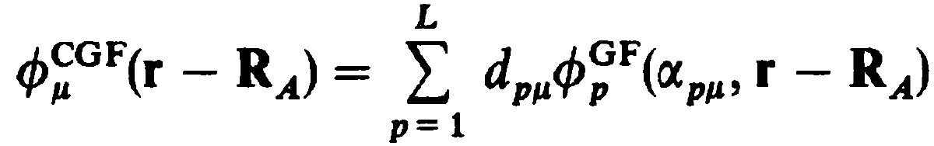
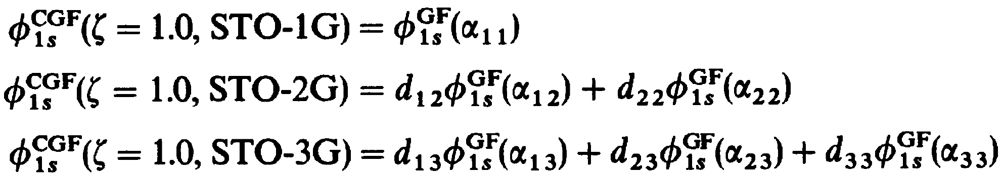
Basis sets
Since GTOs are easy to integrate yet have drawbacks, we can use linear combinations of GFs (primitives)
This is called basis set contraction and the contracted function is called a contracted Gaussian function (CGF) where L is called the length of contraction, d is called contraction coefficient, and ⍺ is called contraction exponent. We then fit these CGFs with length L (STO-LG) to STOs:
This contraction scheme for STO-3G is (3s)/[1s]

Slide 5
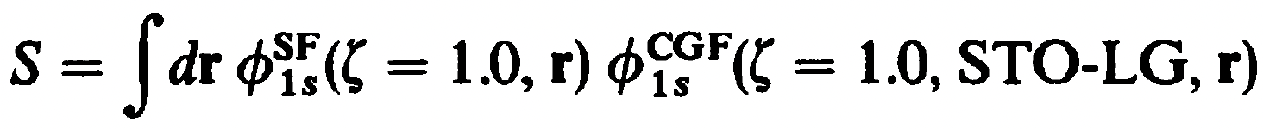
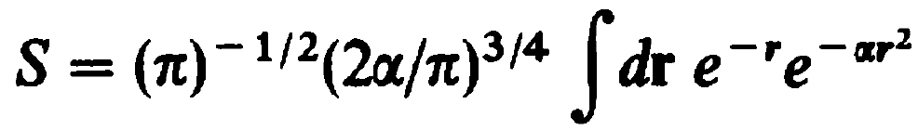
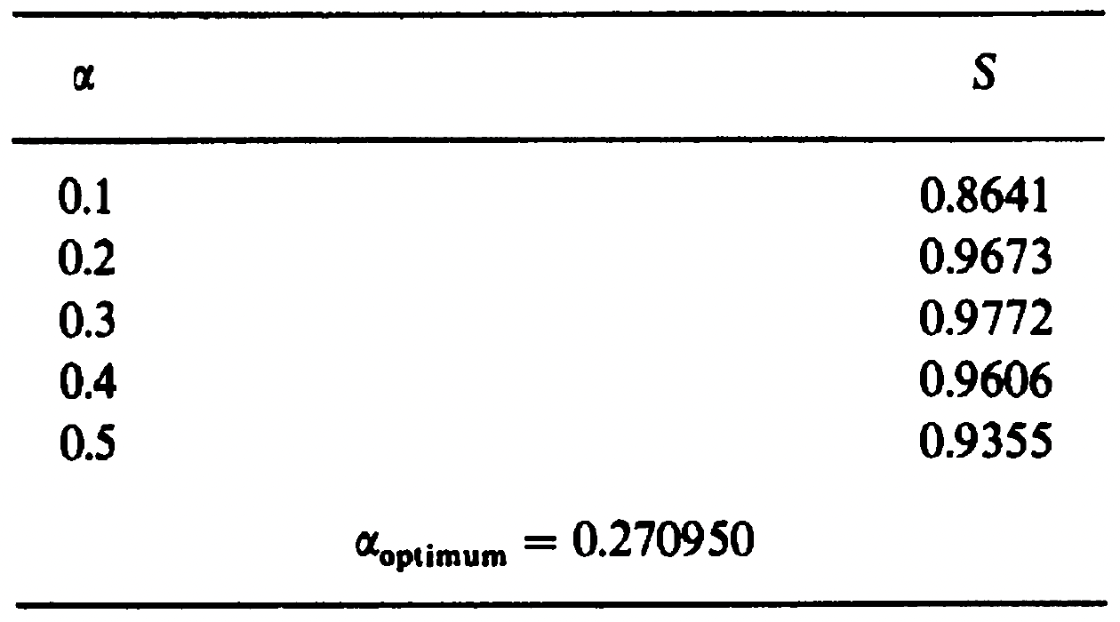
Basis sets
The fitting procedure minimizes
or equivalently, maximizes the overlap S since both functions are normalized.
For example, S for STO-1G is
and the corresponding optimal ⍺ is 0.270950

Slide 6
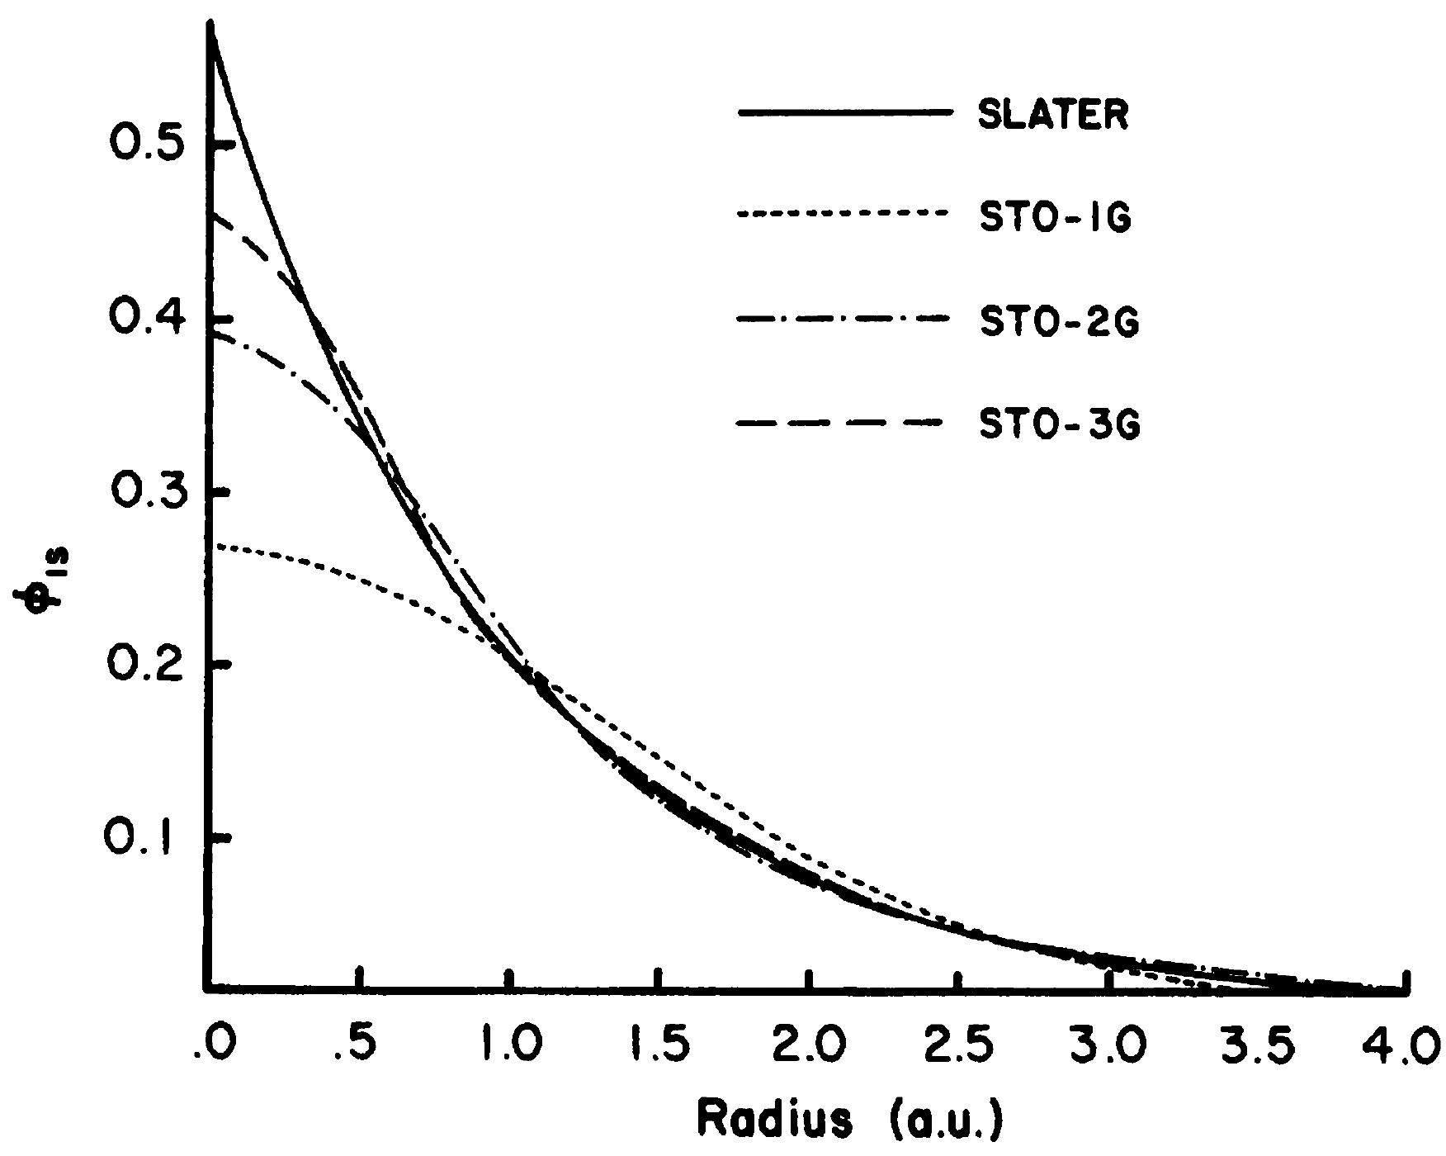
Basis sets

Slide 7
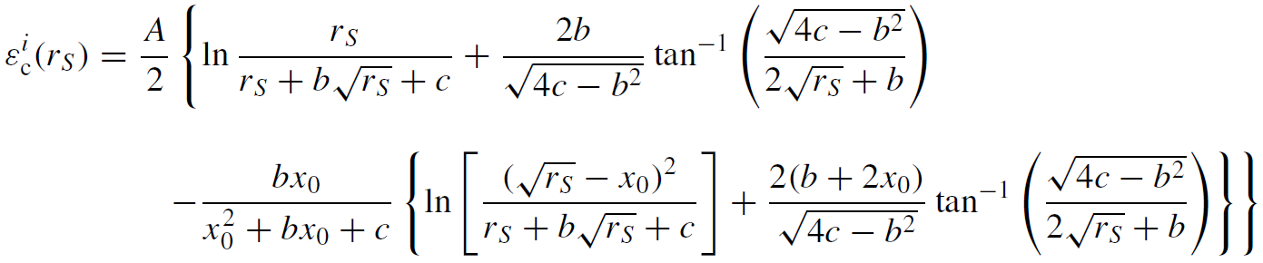
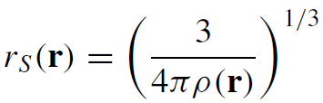
Functional form
Unfortunately, no analytical derivation has been found for the correlation energy density even for UEG. Hence, instead, Vosko, Wilk, and Nusair (VWN) proposed a local functionals that fit numerical results of simulations of correlations energies from quantum Monte Carlo techniques.
The constants A, x0, b, and c were fitted.

Slide 8
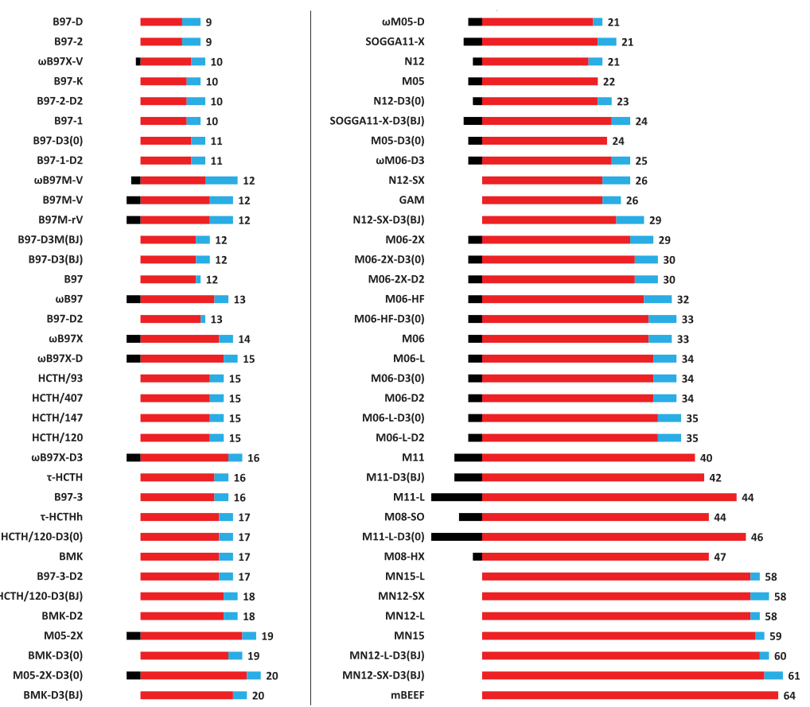
Is DFT non-empirical?

Slide 9
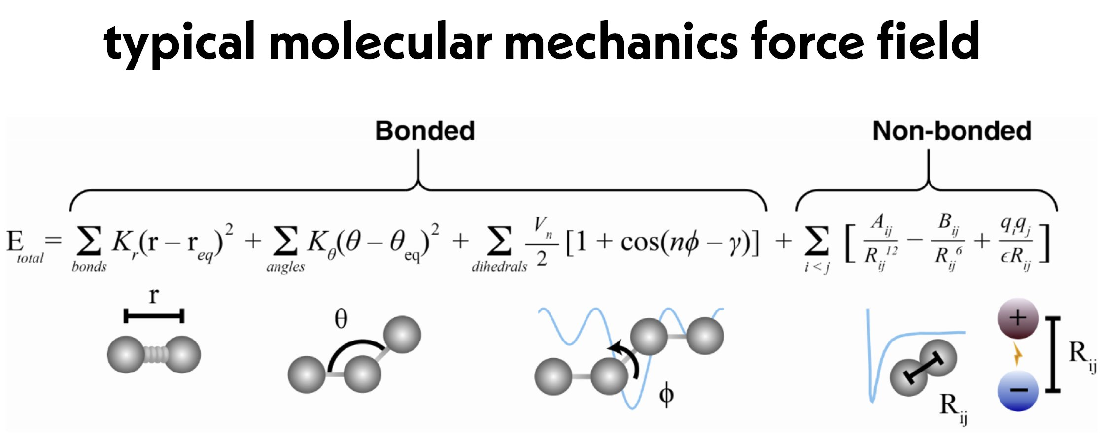
Force field
For the non-bonded term, there are two contributions
The nonbonded term is the most computationally intense term because the number of pairs drastically increases with distance (R³). Hence, cut-off distance is applied to limit the number of interactions.

Slide 10
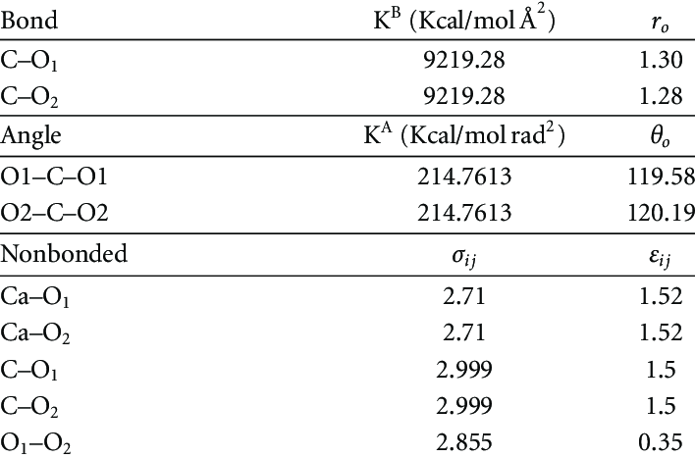
Forcefield parameters

Slide 11
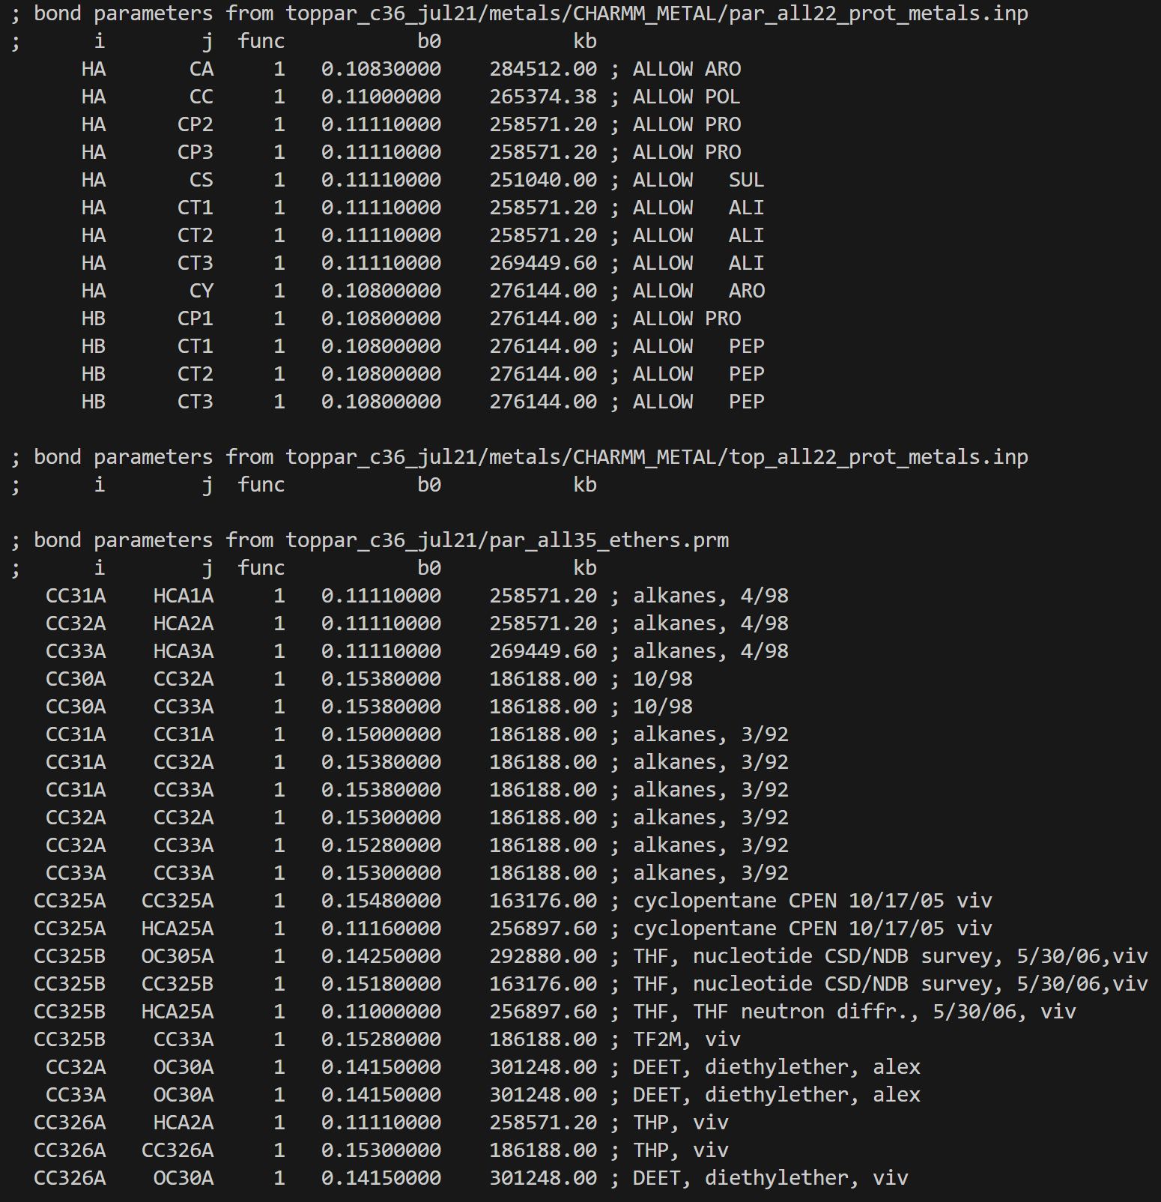
Forcefield parameters

Slide 12
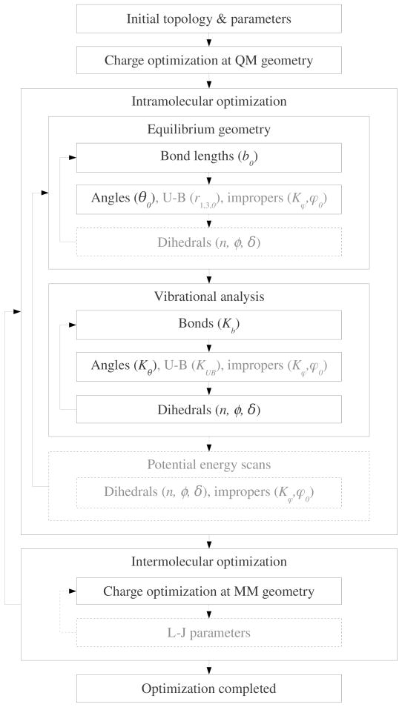
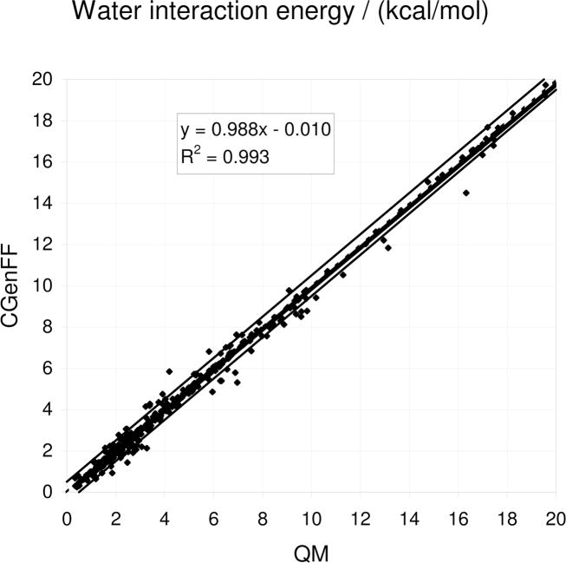
Forcefield parameters

Slide 13
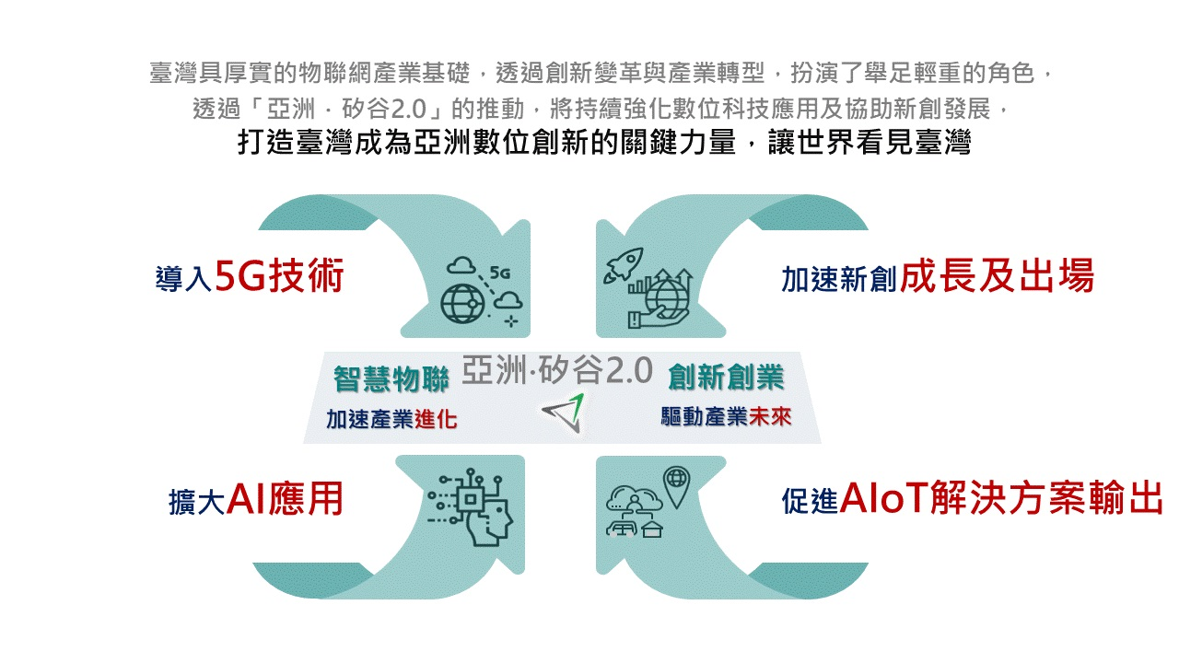
In Taiwan: Asia’s silicon valley 2.0
https://www.ey.gov.tw/achievement/F856D03EF813C8E7 Accessed on 2022/11/17

Slide 14
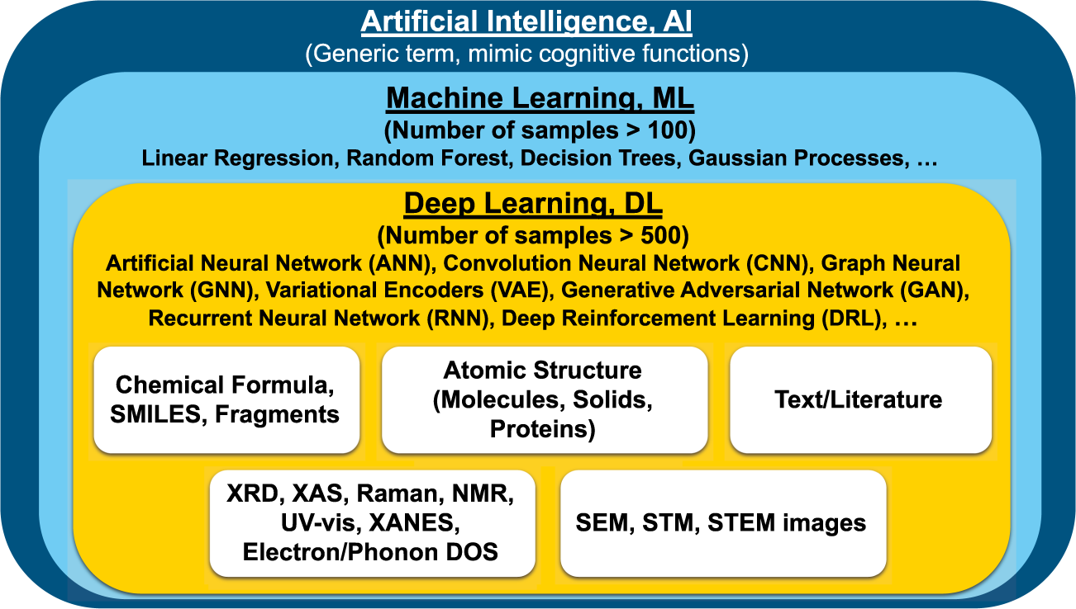
What is Machine Learning
Machine learning is a branch of artificial intelligence (AI) and computer science which focuses on the use of data and algorithms to imitate the way that humans learn, gradually improving its accuracy.
Machine learning is a crucial part of data science. It involves using algorithms and statistical methods to classify, predict, and discover insights in large datasets.
Choudhary, K., DeCost, B., Chen, C. et al. npj Comput Mater 8, 59 (2022)

Slide 15
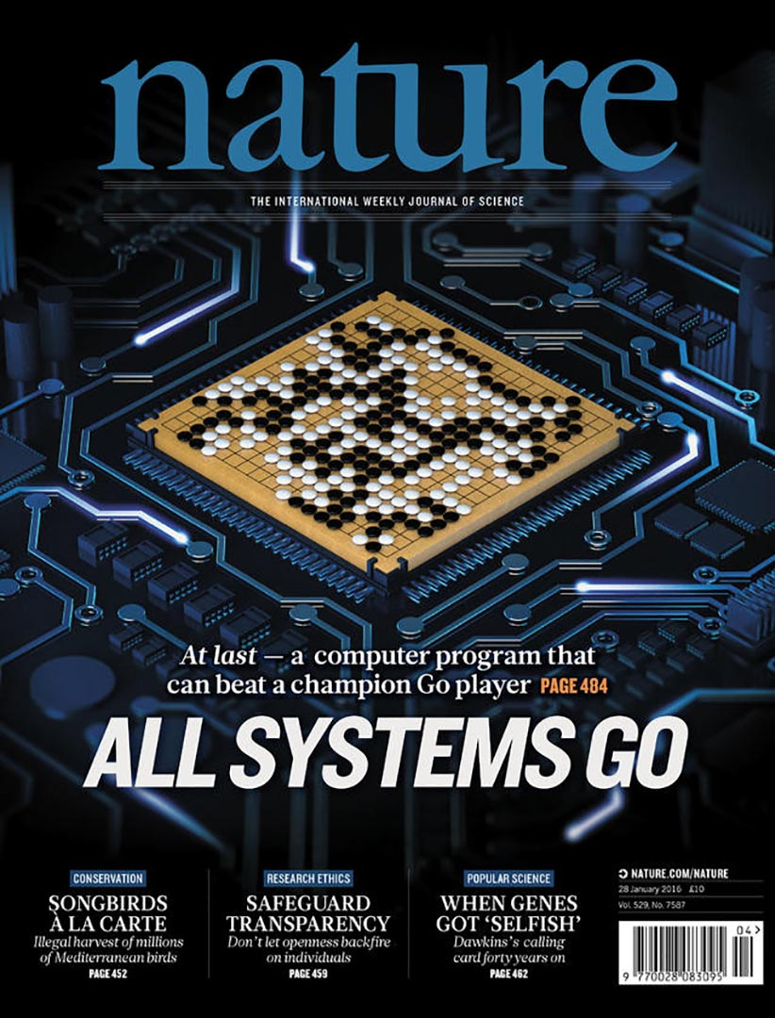
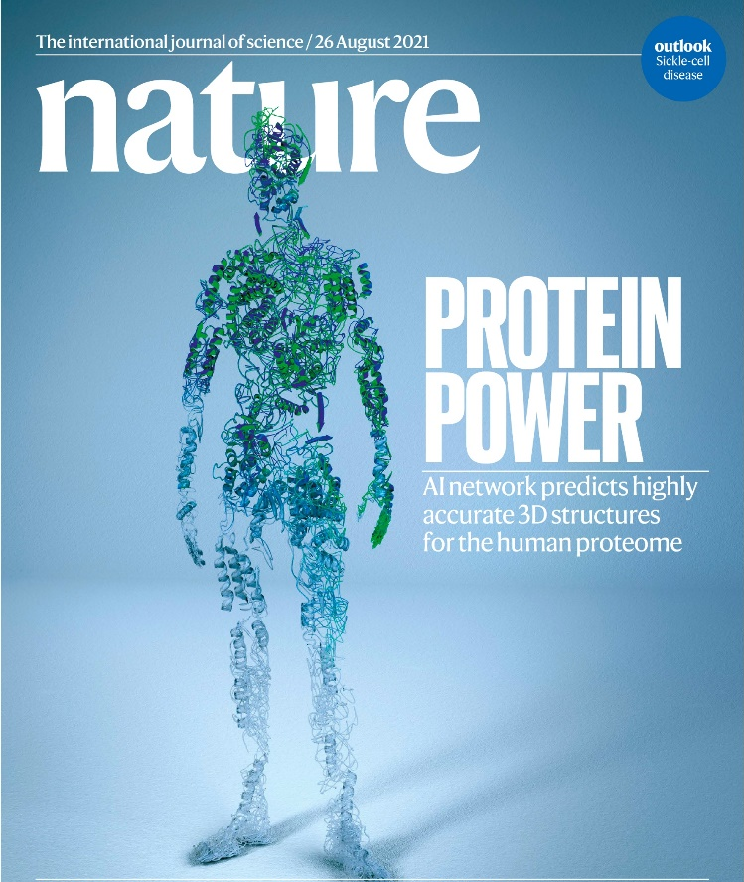
Applications of ML
Silver, D., Huang, A., Maddison, C. et al. Nature 529, 484–489 (2016)
Jumper, J., Evans, R., Pritzel, A. et al. Nature 596, 583–589 (2021)
Notes:
Two alpha that change the world
Alpha go prove that machine learning has it potential that can learning thing very fast , only 40 days, we can make a machine from zero to be a master of the game of go
One of the difficult chess in the world,
Furthermore , another application, Alpha fold2, published on nature ,which can successfully predict protein structure ,why we need to know structure? ,because the functionality of protein is determined by it’s structure

Slide 16
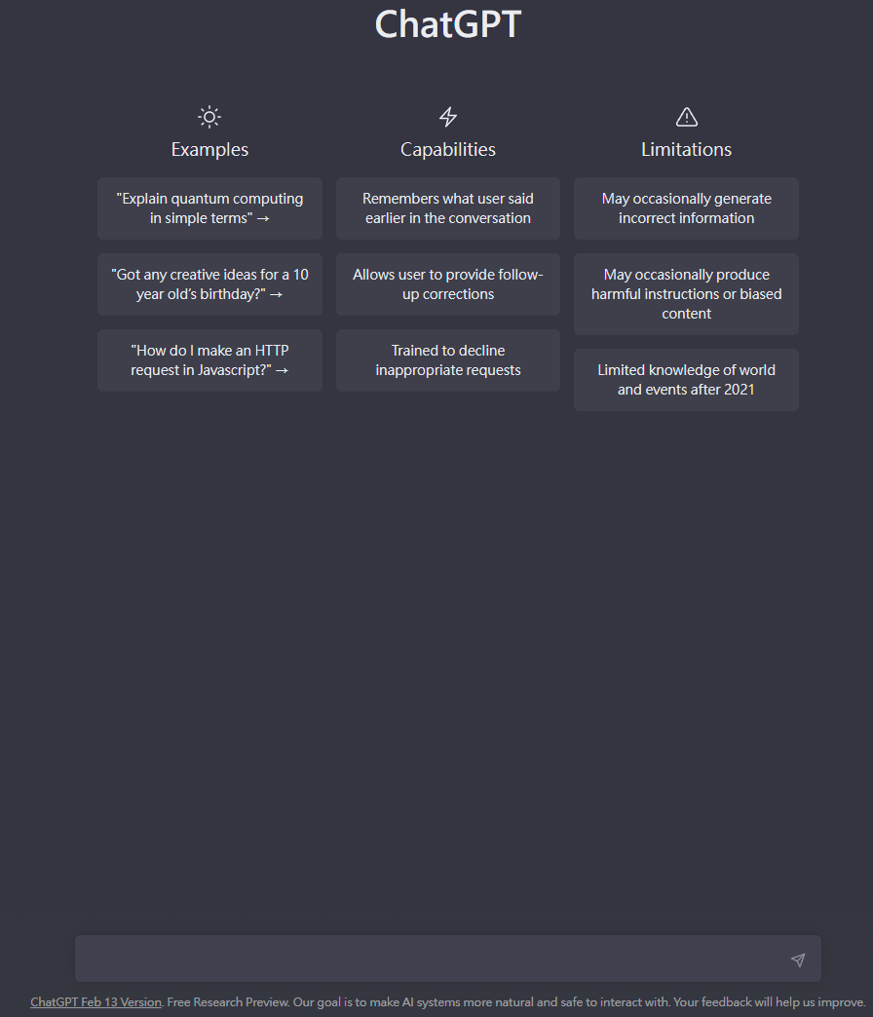

The latest big hit
Generative Pre-trained Transformer
https://chat.openai.com/chat accessed on 2023/03/01

Slide 17
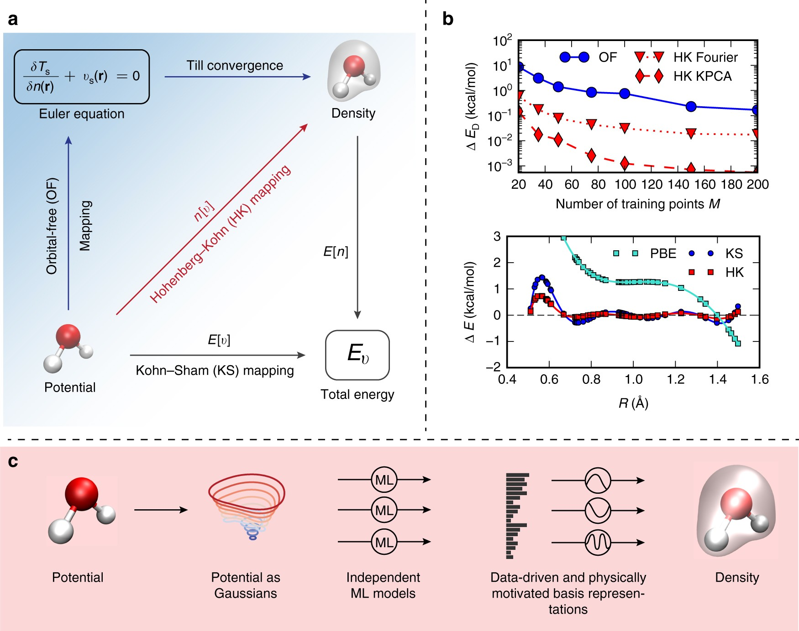
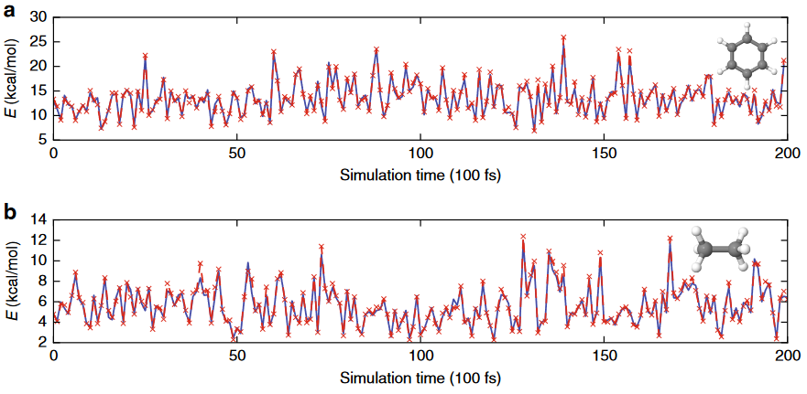
ML meets PhysChem
Brockherde, F.; Vogt, L.; Li, L.; Tuckerman, M. E.; Burke, K.; Müller, K.-R. Bypassing the Kohn-Sham Equations with Machine Learning. Nat Commun 2017, 8 (1), 872.

Slide 18
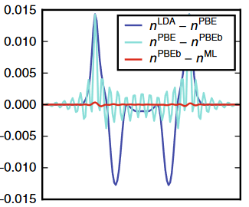
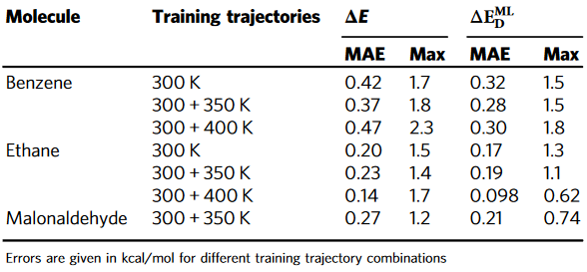
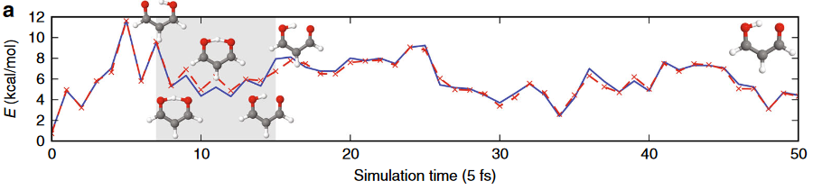
ML meets PhysChem
Brockherde, F.; Vogt, L.; Li, L.; Tuckerman, M. E.; Burke, K.; Müller, K.-R. Bypassing the Kohn-Sham Equations with Machine Learning. Nat Commun 2017, 8 (1), 872.

Slide 19
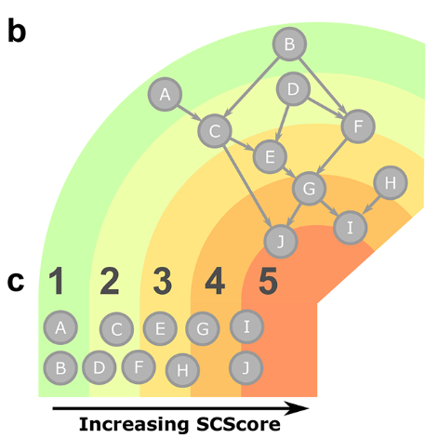
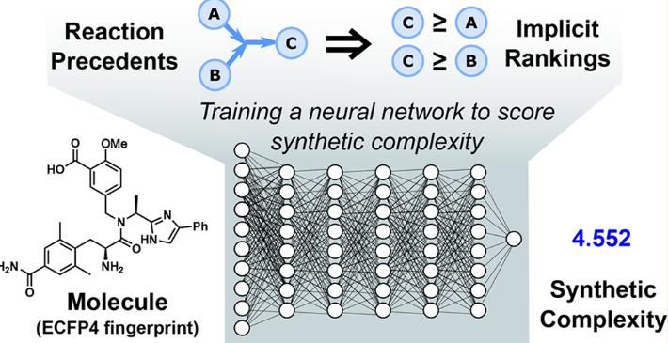
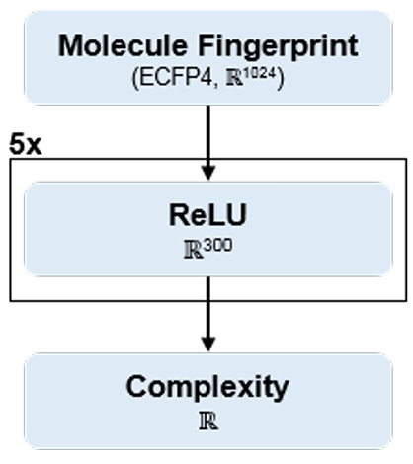

ML meets OrgChem
Coley, C. W.; Rogers, L.; Green, W. H.; Jensen, K. F. SCScore: Synthetic Complexity Learned from a Reaction Corpus. J. Chem. Inf. Model. 2018, 58, 252

Slide 20
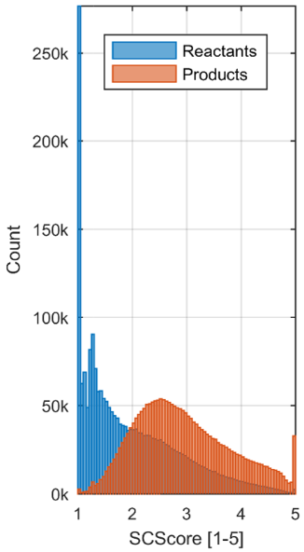
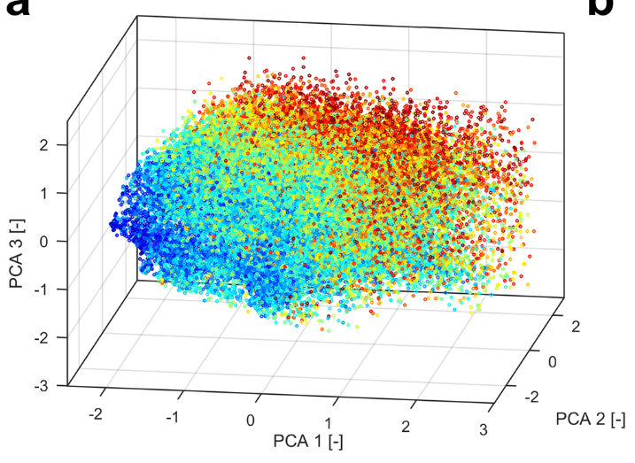
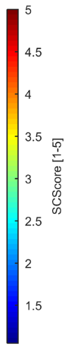
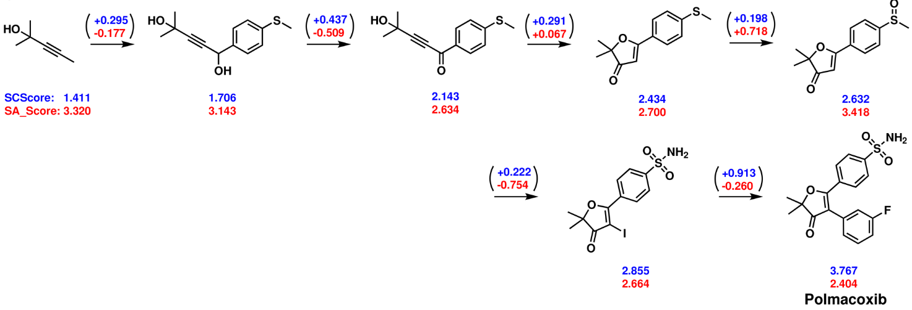
ML meets OrgChem
Coley, C. W.; Rogers, L.; Green, W. H.; Jensen, K. F. SCScore: Synthetic Complexity Learned from a Reaction Corpus. J. Chem. Inf. Model. 2018, 58, 252

Slide 21
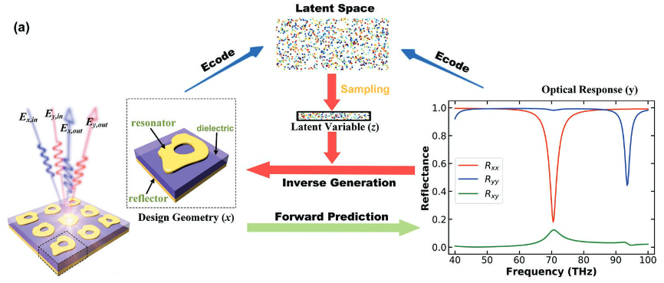
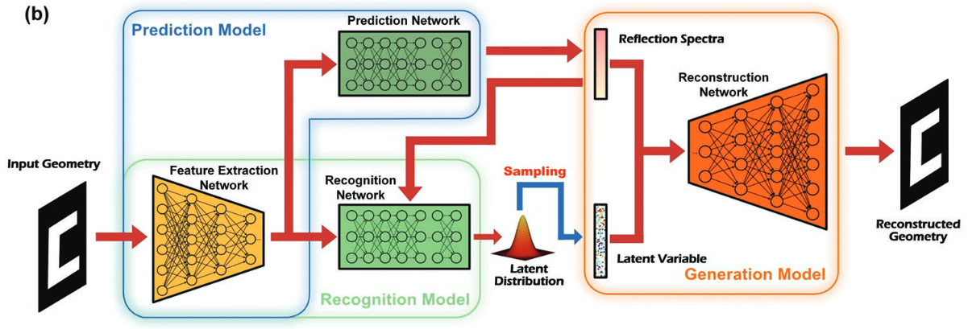
ML meets Materials
Ma, W.; Cheng, F.; Xu, Y.; Wen, Q.; Liu, Y.; Ma, W.; Xu, Y.; Wen, Q.; Liu, Y.; Cheng, F. Adv. Mater 2019, 31

Slide 22

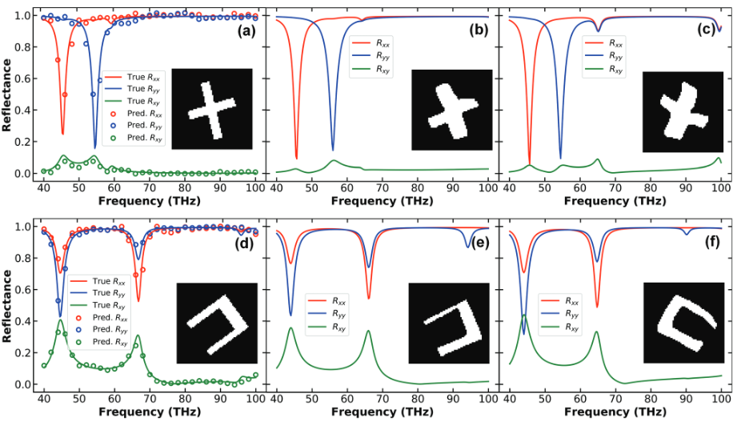
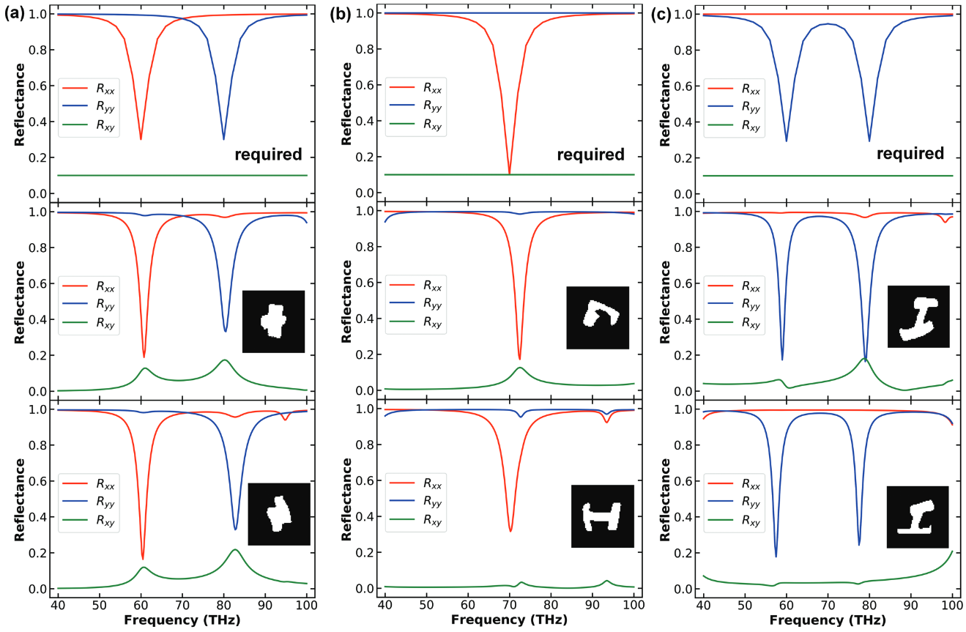
ML meets Materials
Given spectra, produce the expected geometry
For a desired spectra, produce new geometries
Ma, W.; Cheng, F.; Xu, Y.; Wen, Q.; Liu, Y.; Ma, W.; Xu, Y.; Wen, Q.; Liu, Y.; Cheng, F. Adv. Mater 2019, 31

Slide 23
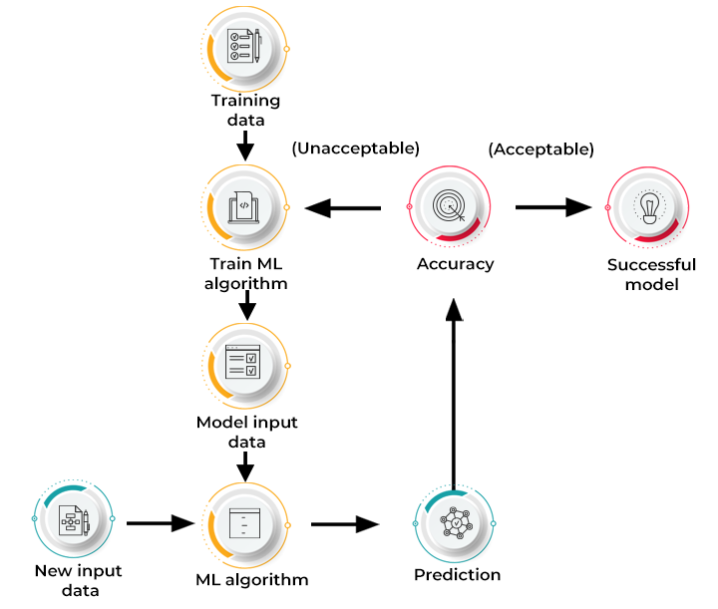
How does Machine Learning work?
https://www.spiceworks.com/tech/artificial-intelligence/articles/what-is-ml/

Slide 24
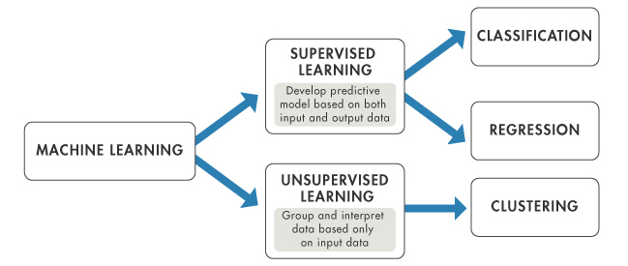
Type of Machine Learning Methods
Supervised Learning: Model learns from labeled training data to make predictions or classifications on unseen data. The goal is for the model to learn patterns and relationships in the training data, enabling it to generalize and make accurate predictions on new, unseen data.
Unsupervised learning: Model learns from unlabeled data without any predefined output labels. The goal of unsupervised learning is to discover patterns, structures, or relationships within the data.
Notes:
Overview of artificial intelligence (AI)

Slide 25

Classification vs. Regression
Classification: A process of finding a function which helps in dividing the dataset into classes In Classification, The task of the classification algorithm is to find the mapping function to map the input(x) to the discrete output(y).
Regression: A process of finding the correlations between dependent and independent variables. It helps in predicting the continuous variables.The task of the Regression algorithm is to find the mapping function to map the input variable(x) to the continuous output variable(y).

Slide 26
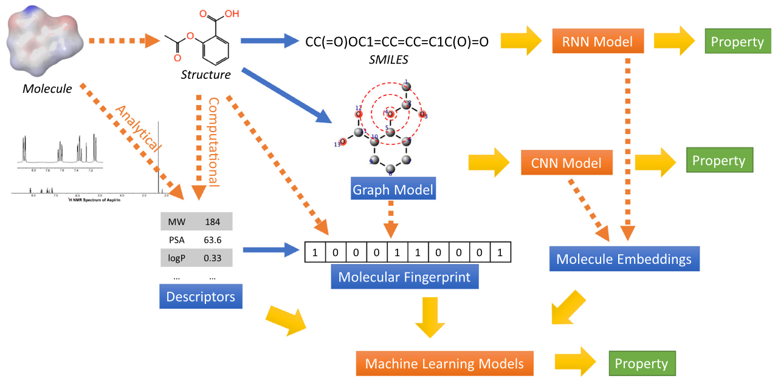
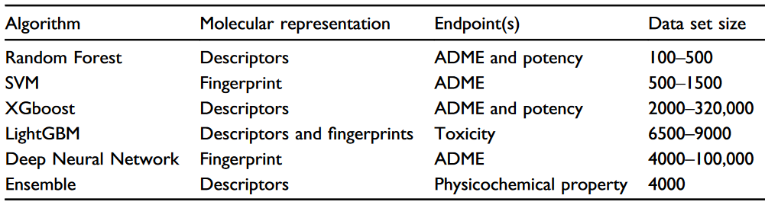
Machine learning Models
Choudhary, K.; DeCost, B.; Chen, C.; Jain, A.; Tavazza, F.; Cohn, R.; Park, C. W.; Choudhary, A.; Agrawal, A.; Billinge, S. J. L.; Holm, E.; Ong, S. P.; Wolverton, C. Recent Advances and Applications of Deep Learning Methods in Materials Science. npj Comput Mater 2022, 8 (1), 1

Slide 27
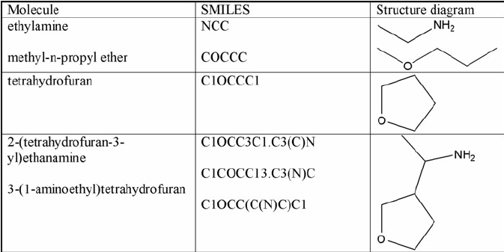
What is SMILES?
SMILES (Simplified Molecular Input Line Entry System) A chemical notation that allows a user to represent a chemical structure in a way that can be used by the computer.

Slide 28
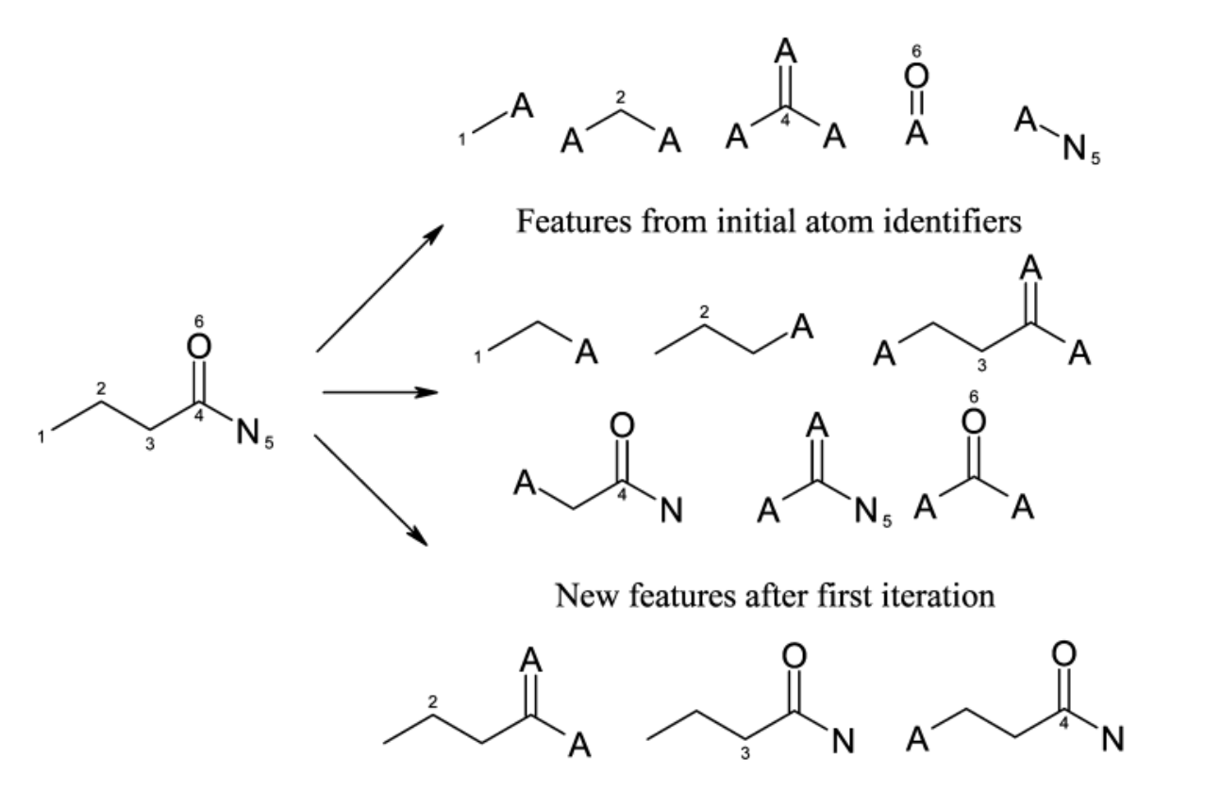
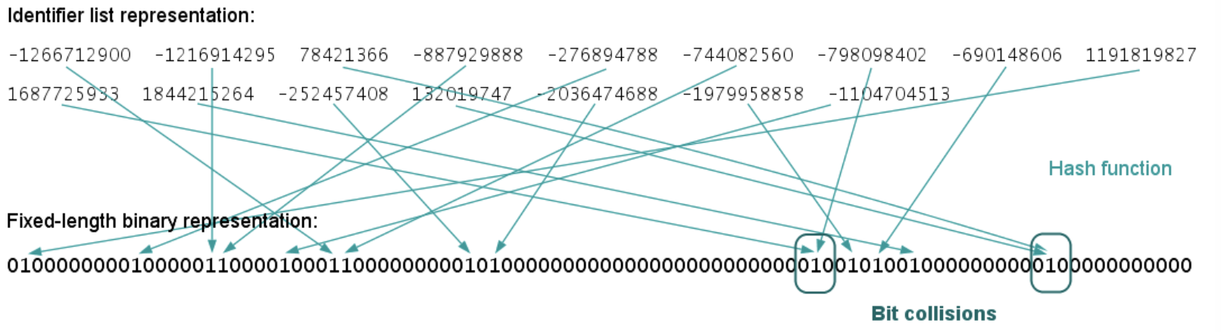
Molecular Fingerprint
Molecule fingerprints are binary bit strings that represent the structural features of a molecule. Uses a circular neighborhood around each atom in a molecule to capture local structural information.

Slide 29
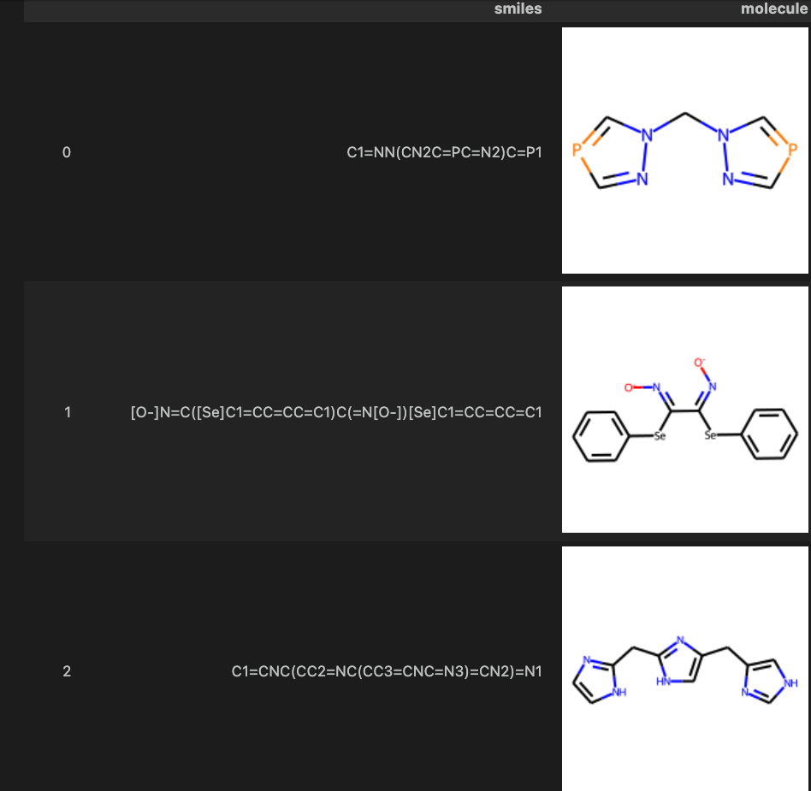
Interactive
Login to ${USER}@ln01.twnia2.twcc.aii
Go to exercise1
Click smi.ipynb
Run kernel
We can used python package easily show smile string to molecules

Slide 30
Machine learning Models
Choudhary, K.; DeCost, B.; Chen, C.; Jain, A.; Tavazza, F.; Cohn, R.; Park, C. W.; Choudhary, A.; Agrawal, A.; Billinge, S. J. L.; Holm, E.; Ong, S. P.; Wolverton, C. Recent Advances and Applications of Deep Learning Methods in Materials Science. npj Comput Mater 2022, 8 (1), 1

Slide 31
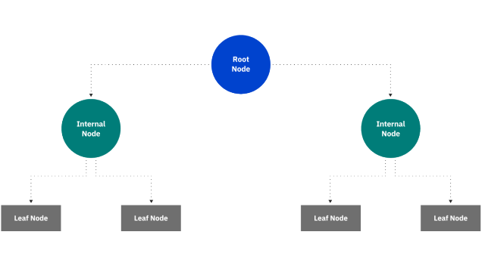
Decision Tree
A decision tree is a non-parametric supervised learning algorithm, which is utilized for both classification and regression tasks. It has a hierarchical, tree structure, which consists of a root node, branches, internal nodes and leaf nodes.

Slide 32
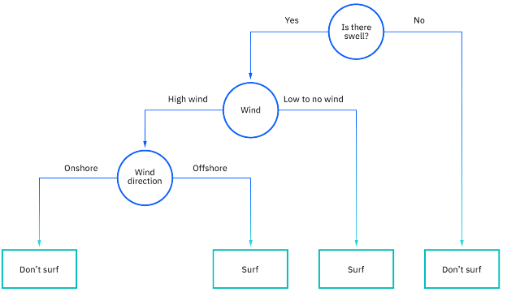
Decision Tree
A decision tree starts with a root node, which does not have any incoming branches. The outgoing branches from the root node then feed into the internal nodes, also known as decision nodes. Based on the available features, both node types conduct evaluations to form homogenous subsets, which are denoted by leaf nodes, or terminal nodes. The leaf nodes represent all the possible outcomes within the dataset.
https://www.ibm.com/topics/decision-trees

Slide 33
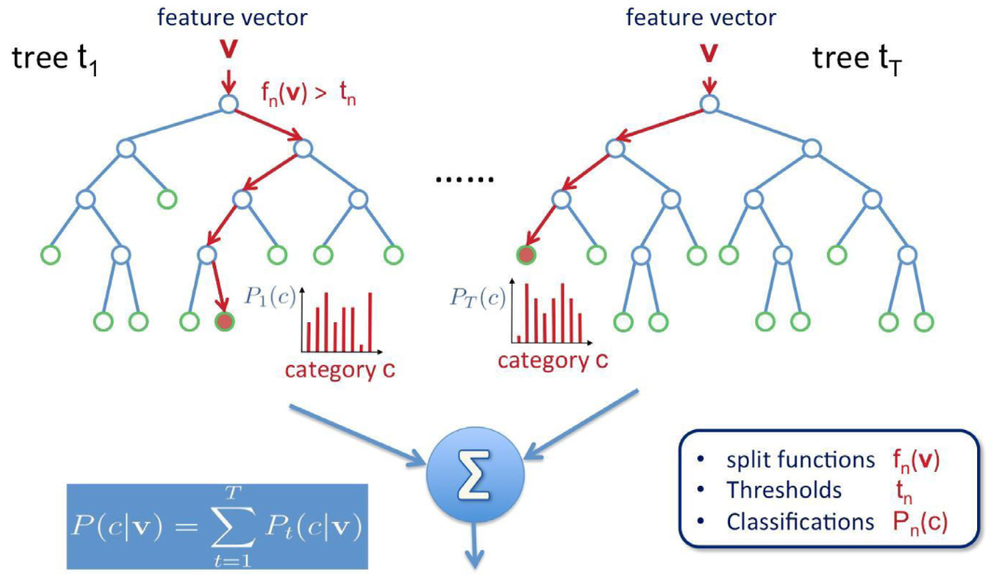
Random forest
Parameters:
node size,
number of trees,
number of features sampled.
Cano, G.; Garcia-Rodriguez, J.; Garcia-Garcia, A.; Perez-Sanchez, H.; Benediktsson, J. A.; Thapa, A.; Barr, A. Automatic Selection of Molecular Descriptors Using Random Forest: Application to Drug Discovery. Expert Systems with Applications 2017, 72, 151.

Slide 34
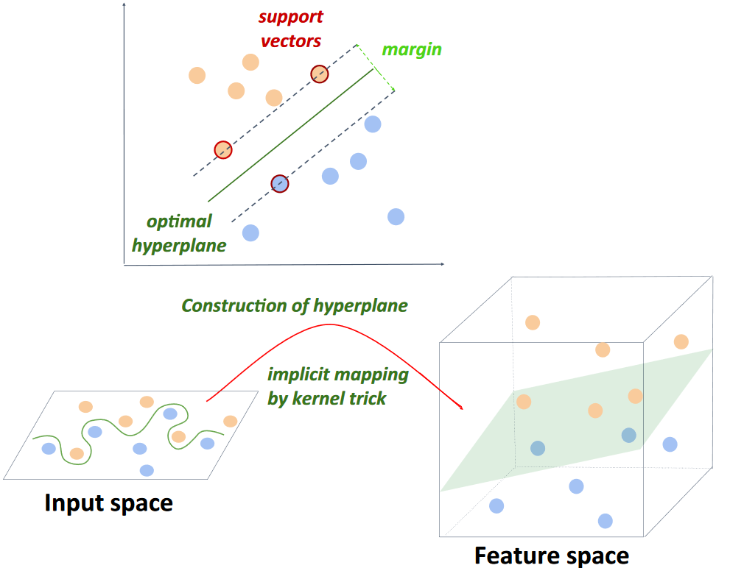
Support vector machine
Badillo, S.; Banfai, B.; Birzele, F.; Davydov, I. I.; Hutchinson, L.; Kam-Thong, T.; Siebourg-Polster, J.; Steiert, B.; Zhang, J. D. An Introduction to Machine Learning. Clinical Pharmacology & Therapeutics 2020, 107, 871

Slide 35
Machine learning Models
Choudhary, K.; DeCost, B.; Chen, C.; Jain, A.; Tavazza, F.; Cohn, R.; Park, C. W.; Choudhary, A.; Agrawal, A.; Billinge, S. J. L.; Holm, E.; Ong, S. P.; Wolverton, C. Recent Advances and Applications of Deep Learning Methods in Materials Science. npj Comput Mater 2022, 8 (1), 1

Slide 36
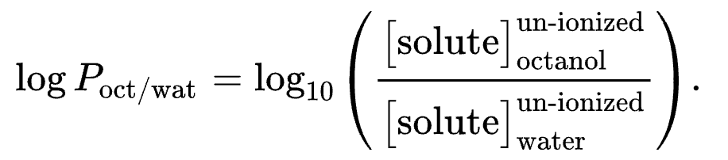
What is logp and TPSA
1.LogP (Partition Coefficient): LogP stands for logarithm of the partition coefficient. It is a measure of the lipophilicity or hydrophobicity of a molecule. LogP indicates how a molecule partitions between a nonpolar solvent (usually octanol) and water.
2.TPSA (Topological Polar Surface Area): TPSA represents the total polar surface area of a molecule. It is a measure of the surface area of a molecule that is involved in polar interactions, such as hydrogen bonding and dipole-dipole interactions. TPSA is calculated by summing up the contributions of individual polar atoms and functional groups in the molecule.

Slide 37
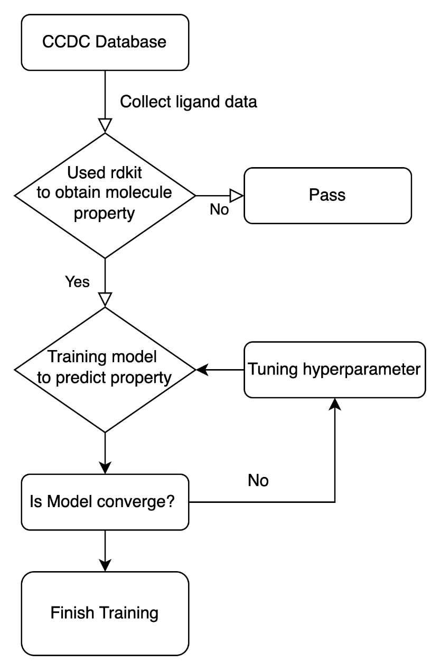
Interactive
1.Click smi_inform_retriver.ipynb
2.Run kernel
3.Used smi_infrom_retrivert to obtain logP, TPSA
Work Flow

